Slide 1

Capstone Project
Marcus Elliott
07 November 2023

Slide 2
Outline
Executive Summary
Introduction
Methodology
Results
Conclusion
Appendix

Slide 3
Executive Summary
Summary of methodologies
Data Collection and Wrangling
Exploratory Data Analysis
Visual Analytics
Predictive Analysis
Summary of all results
Exploratory Data Analysis Results
Interactive Dashboard
Predictive Analysis
Geospatial Analytics

Slide 4
Introduction
Using data science tools and processes to determine how often the first stage SpaceX Falcon 9 will land.
This will help determine/predict the total cost of the launch.

Slide 5
Methodology
Data Collection
Made a GET request for the SpaceX REST API
Data Collection
Used .fillna() to remove NAN values
Used .value_counts() to get the number of launches per site and occurrence of each orbit
Exploratory Data Analysis
Used SQL queries to evaluate the SpaceX dataset
Used Pandas and Matplotlib to visualise the relationships between variables
Interactive Visuals
Used Folium to provide geospatial information on the launch sites
Used Plotly Dash to create a dashboard
Data Modelling and Evaluation
Used Scikit-Learn to process, split and train the data
Created confusion matrices for each classification model

Slide 6
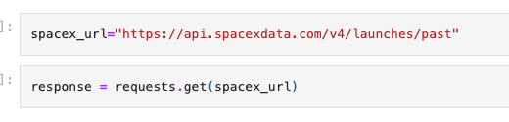
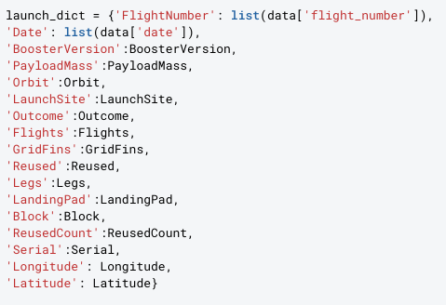

Data Collection – SpaceX API
Made a GET response to the SpaceX API.
Converted response to JSON, then to a Pandas DataFrame.
Defined the lists for the data to be stored in and used these lists as values to create the dataset.
Filtered the data frame to only include Falcon 9 launches.
Github

Slide 7

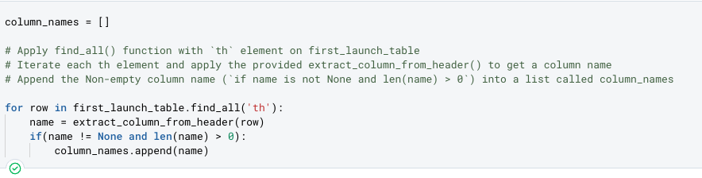
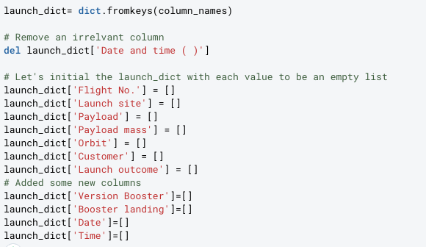
Data Collection - Scraping
Used requests.get() to request the HTML page from the URL
Created a BeautifulSoup object to find all the tables in the HTML page
Extracted the column header names
Created a dictionary from the column names
Converted the dictionary into a data frame
Github

Slide 8
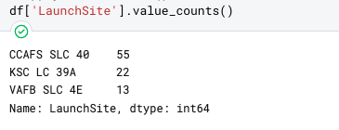
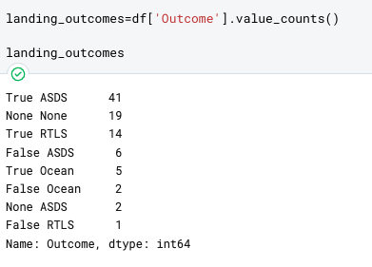
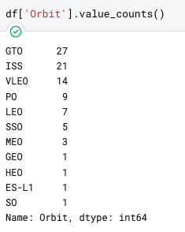
Data Wrangling
Aim was to assign a binary value to the success or failure of a landing.
Used .value_counts() to determine the number of launches per site, number and occurrence of the orbit, and landing outcome per orbit type.
Github

Slide 9

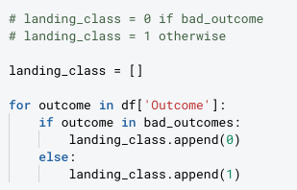

Data Wrangling
Created a set of unsuccessful outcomes.
Created landing_class, where a bad outcome is set to 0, otherwise it is 1.
Created a class column to show these results, and exported it as a CSV.
Github

Slide 10
EDA with Data Visualization
Scatter Charts
Flight number and payload mass
Launch site and flight number
Launch site and payload mass
Flight number and orbit
Bar Chart
Class and orbit
Line Chart
Class and year
Github

Slide 11
EDA with SQL
Displayed the unique names of the launch sites
Displayed 5 records where the launch site begins with CCA
Got the total payload mass launched by NASA (CRS)
Displayed the average payload mass carried by booster version F9 v1.1
Found the date the first successful landing outcome on a ground pad
Listed the names of the boosters that had success on the drone ship and had a payload mass between 4000 and 6000
Listed the total successful and unsuccessful missions
Listed the names of the booster versions that carried the maximum payload mass
Listed the mission details for the months in the year 2015
Ranked the landing outcomes in descending order between the dates 2010-06-04 and 2017-03-20
Github

Slide 12
Build an Interactive Map with Folium
Created a circle using folium.Circle() to show where the NASA Johnson Space Center is located with a popup label.
Used folium.Marker() to show each launch site on the map.
Created coloured launch markers to show the outcome of a launch.
Used MarkerCluster() to cluster the launches on the map for ease of naviagtion.
Used Polyline to calculate and show the distance between a launch site and coastline point, city, railway etc.
Github

Slide 13
Build a Dashboard with Plotly Dash
Created a pie chart to show the successful launch count for each site. Each launch site can be selected for an in depth view
Created a scatter chart to show the correlation between payload and launch success
Github

Slide 14
Predictive Analysis (Classification)
Model Development
Loaded the data frame and standardised it
Split the data into training and test data sets
Model Evaluation
Used a confusion matrix to determine the accuracy of each model
Finding the best model
Used a box plot to determine the best score and accuracy score

Slide 15
Results
Exploratory data analysis results
Interactive analytics demo in screenshots
Predictive analysis results

Slide 16
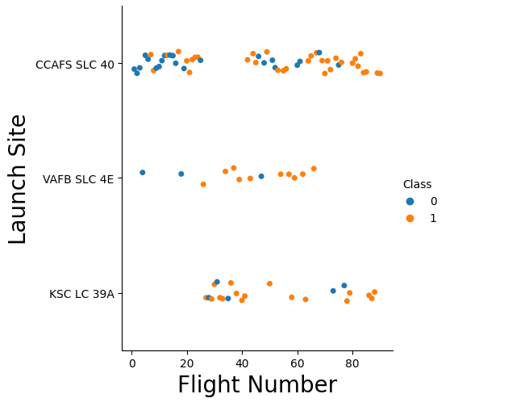
Flight Number vs. Launch Site
Shows that site CCAFS SLC 40 has had the most launches, with them becoming more successful over time
This trend continues for site VAFB SLC 4E, however it has had fewer launches
Trend continues for site KSC LC 39A

Slide 17
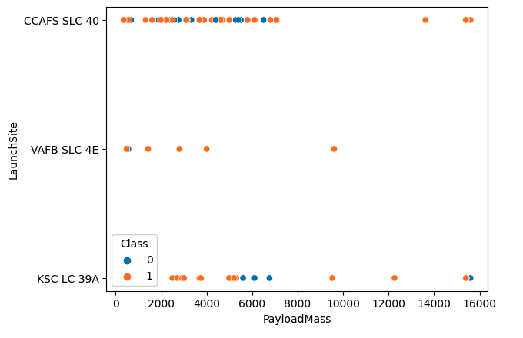
Payload vs. Launch Site
This shows a trend for all sites that as the payload mass increases, so does the amount of failed launches

Slide 18
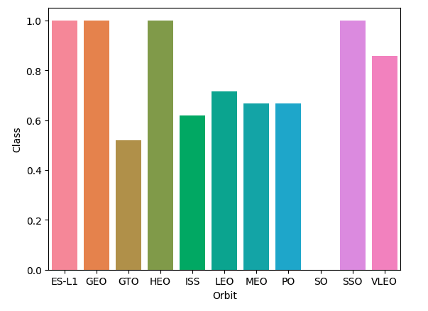
Success Rate vs. Orbit Type
This bar chart shows that the orbit types ES-L1, GEO, HEO and SSO have been the most successful

Slide 19
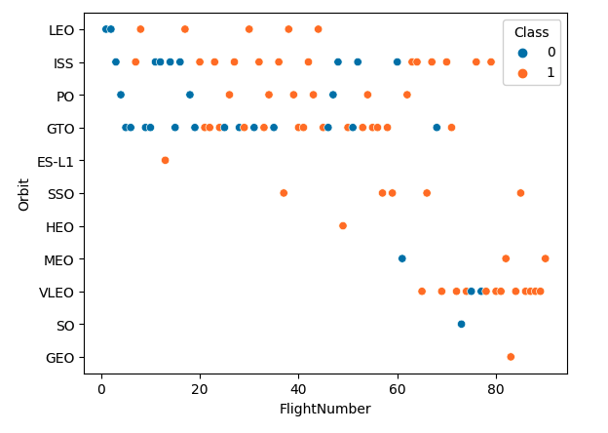
Flight Number vs. Orbit Type
This chart shows that in LEO the failures occurred in the first few flights

Slide 20
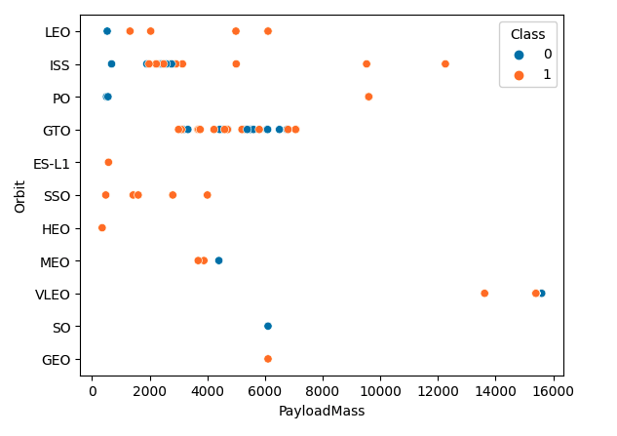
Payload vs. Orbit Type
This chart shows success when there is a heavier payload at PO, LEO and ISS

Slide 21
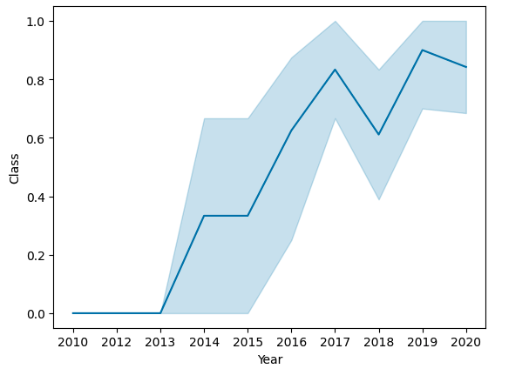
Launch Success Yearly Trend
This chart shows launches have been more successful over time, bar a plip in 2018

Slide 22
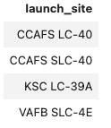
All Launch Site Names
Used the following SQL query to get the unique launch site names

Slide 23
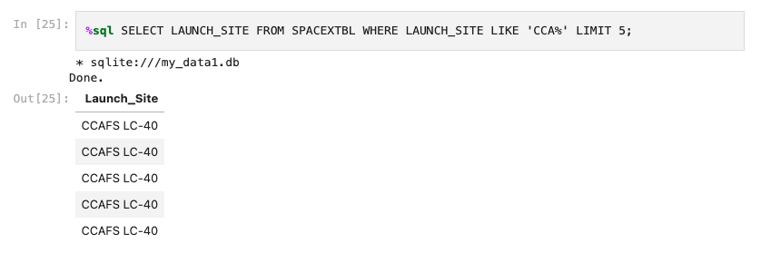
Launch Site Names Begin with 'CCA'
Used the following query to get the site names beginning with CCA

Slide 24
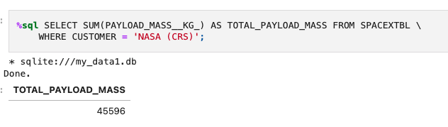
Total Payload Mass
Used the following query to find the payload mass from the boosters launched by NASA (CRS)

Slide 25
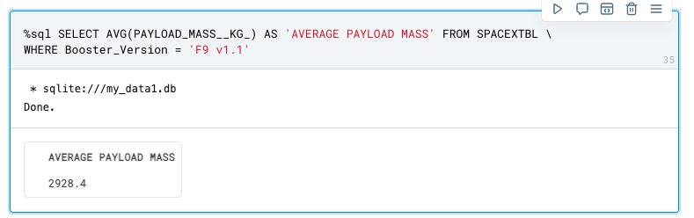
Average Payload Mass by F9 v1.1
Used the following query to find the average payload mass carried by booster F9 v1.1

Slide 26
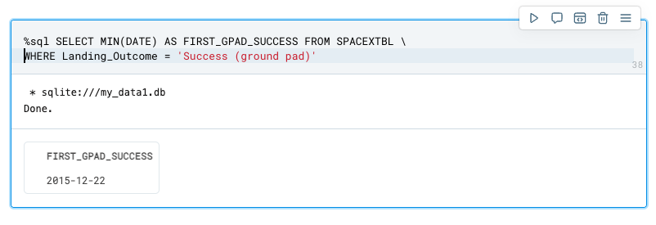
First Successful Ground Landing Date
Used the following query to find the first successful ground landing date

Slide 27
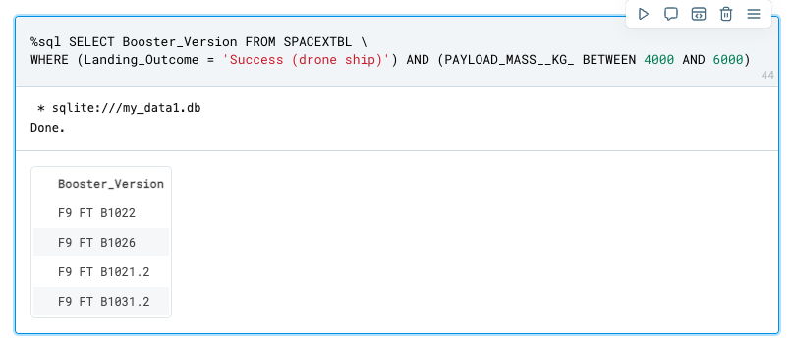
Successful Drone Ship Landing with Payload between 4000 and 6000
Used the following query to find the booster versions that successfully landed on a drone ship and had a payload mass between 4000 and 6000 KG

Slide 28
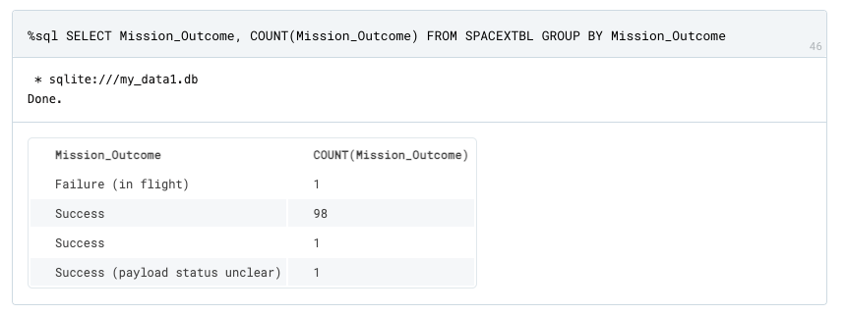
Total Number of Successful and Failure Mission Outcomes
Used the following query to find the total number of successes and failures

Slide 29
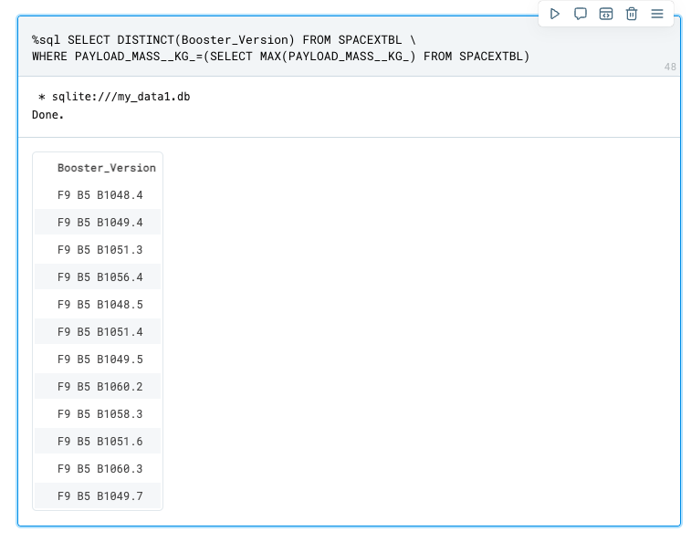
Boosters Carried Maximum Payload
Used the following query to list the booster names that have carried the max payload mass

Slide 30

2015 Launch Records
Used the query to list the failures when landing on a drone ship in 2015

Slide 31
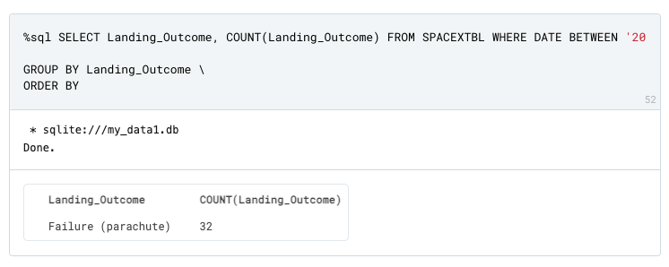
Rank Landing Outcomes Between 2010-06-04 and 2017-03-20
Used the following query to rank the landing outcomes between 2010-06-04 and 2017-03-20

Slide 32
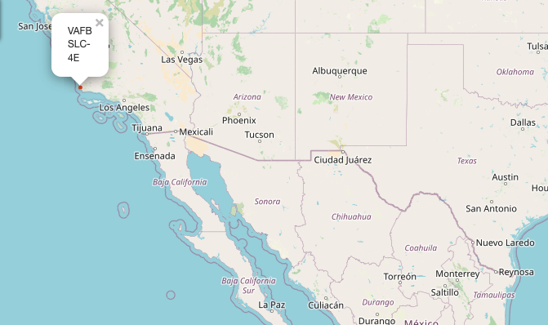
Launch Sites
Image shows the launch sites on the west coast

Slide 33
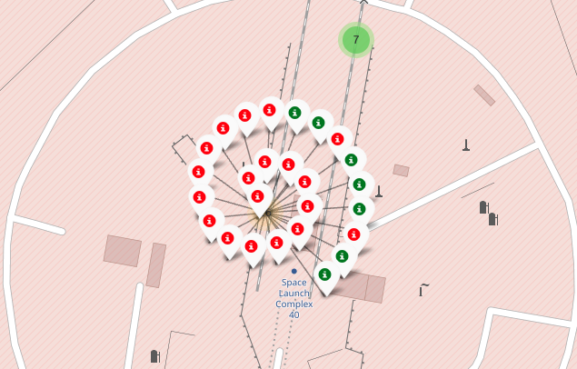
Successes/Failures Per Site
This cluster colour codes the successes and failures of each launch

Slide 34
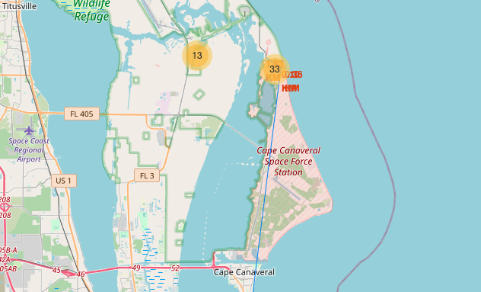
Proximity of Launch Site
The map image shows the proximity of the launch site to coastline, railways etc

Slide 35
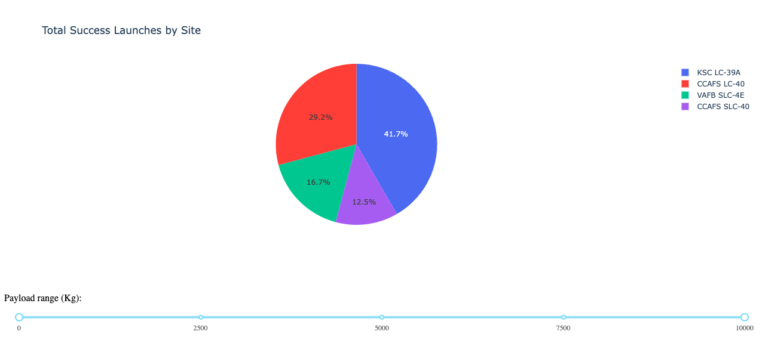
Total Success per Site Pie Chart
Replace <Dashboard screenshot 1> title with an appropriate title
Show the screenshot of launch success count for all sites, in a pie chart
Explain the important elements and findings on the screenshot

Slide 36
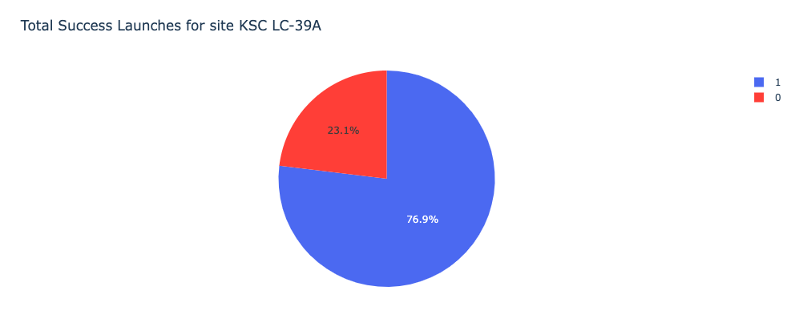
Total Successful Launches for KSC LC-39A
This pie chart shows the percentage of successful launches

Slide 37
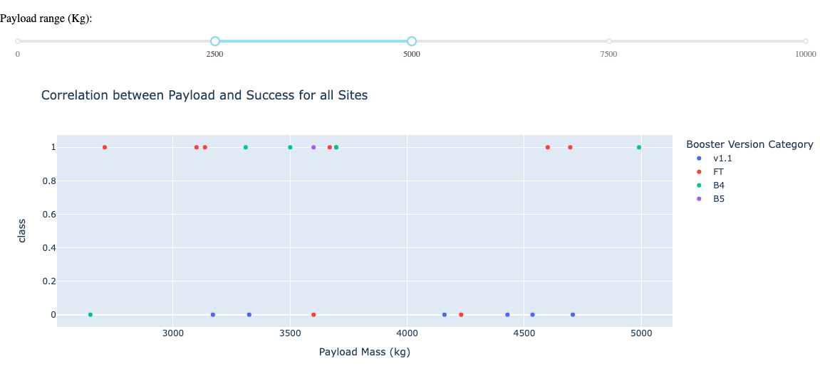
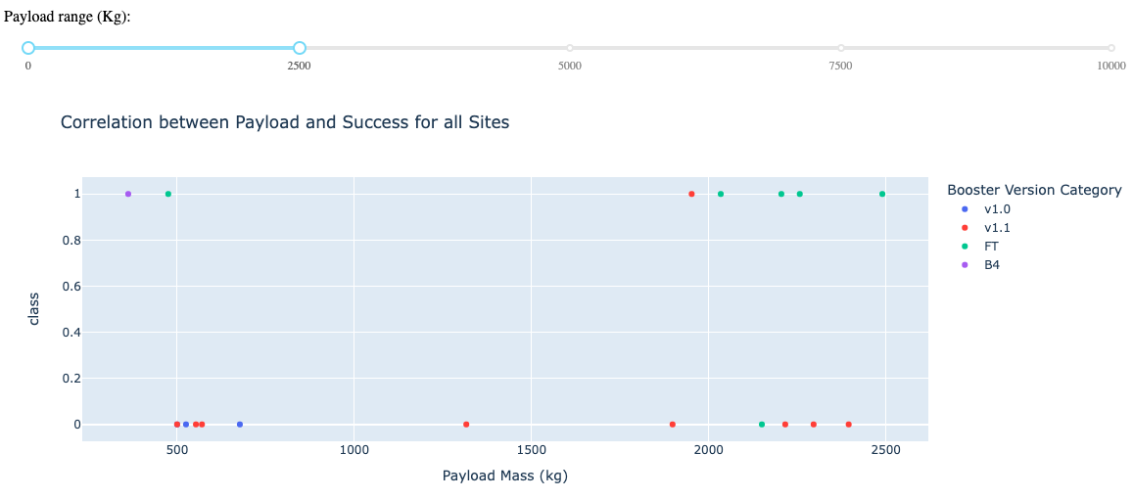
Correlation Between Payload and Success
The following images show payload v success for a payload of 2500 to 5000 kg and 0 to 2500 kg
From this graphic we can see that all boosters have a higher success rate when they have a heavier payload

Slide 38
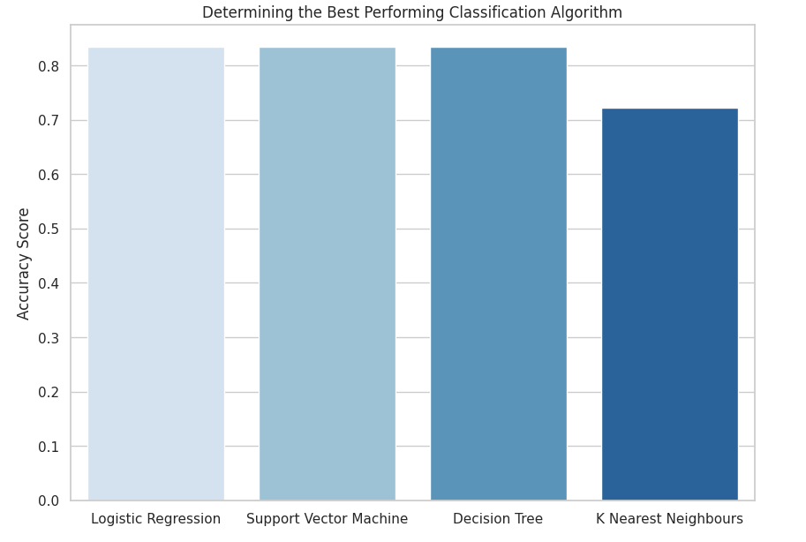
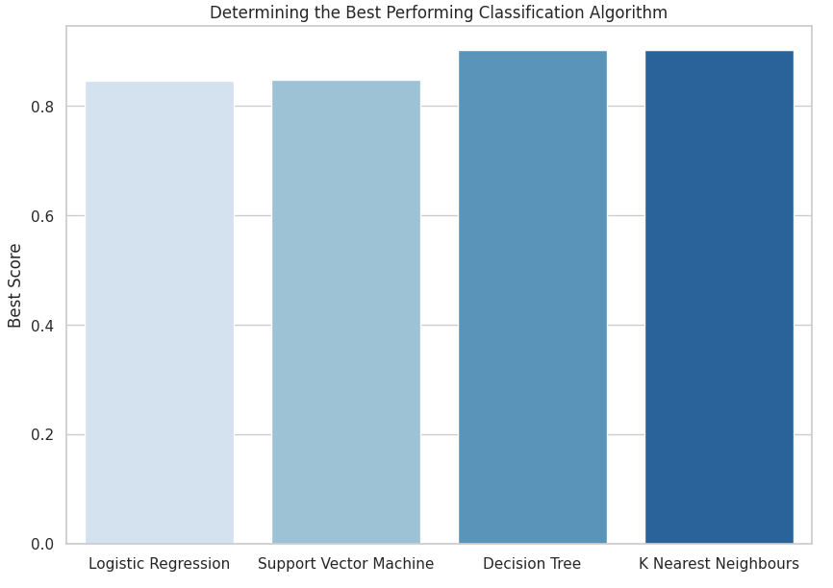
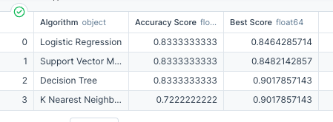
Classification Accuracy
The decision tree algorithm is the most accurate
The Accuracy Score is 83%
The Best Score is 90%

Slide 39
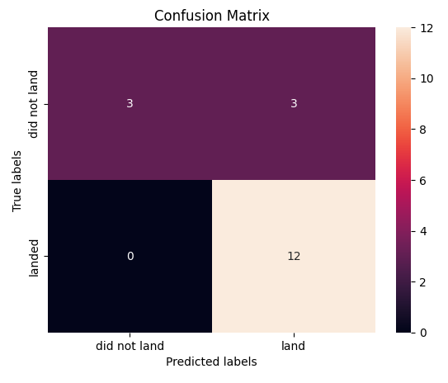
Confusion Matrix
This matrix shows that 3 out of the 18 results were classified incorrectly (top right)
The other 15 results were labelled correctly - 3 did not land and 12 did land

Slide 40
Conclusions
As the number of flights increases, the number of failures decrease
Orbit types GEO, SSO and HEO have the highest success rate
Launches with a heavier payload have an increased chance of success

